Slide 1

CareerCrafter Resume Analyzer
Capstone Project
Review 1
Devyansh Rajput 22MCA10061

Slide 2
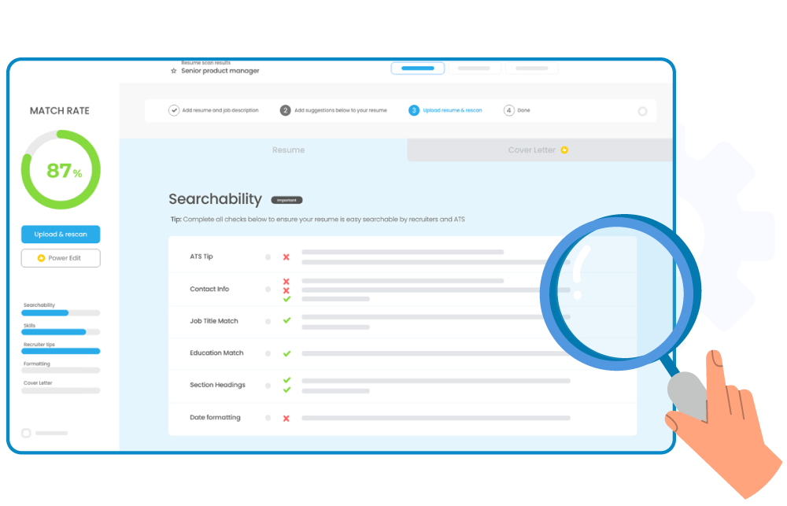
Content
Introduction
Problem Statement
Feasibility
Scope
Methodology & Approach
Hardware & Software Requirements
Tools & Technologies Used
Conclusion

Slide 3

Introduction
CareerCrafter, is a tool that aims to assist job seekers in their pursuit of professional growth by providing customized guidance.
CareerCrafter is a resume analyzer designed to transform the job application process by providing personalized insights and recommendations to job seekers.
CareerCrafter is more than just a tool, it is a career companion that helps job seekers achieve their career goals.
CareerCrafter aligns with this trend by analyzing skills and providing recommendations for skill enhancement.

Slide 4
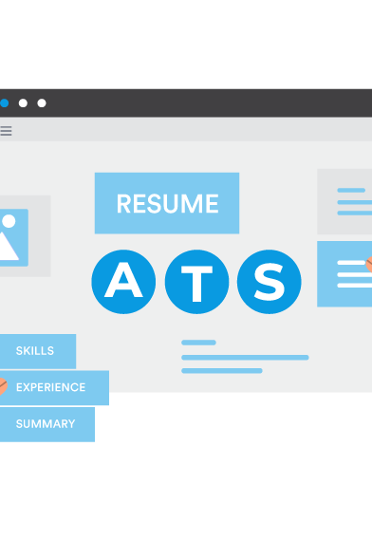
Problem Statement
In today's competitive job market, crafting a perfect resume is crucial. However, many job seekers find it challenging to understand how their resumes align with industry standards and expectations. CareerCrafter solves this problem by analyzing resumes and providing actionable feedback and guidance.
Recent trends in the job market indicate a shift towards resumes that focus more on skills.
The job market has undergone a massive shift in the aftermath of the recession. With a surge in job losses and a highly competitive landscape, it has become important for job seekers to have a standout resume. CareerCrafter is a valuable tool for job seekers, providing an edge in the application process during these turbulent times.

Slide 5
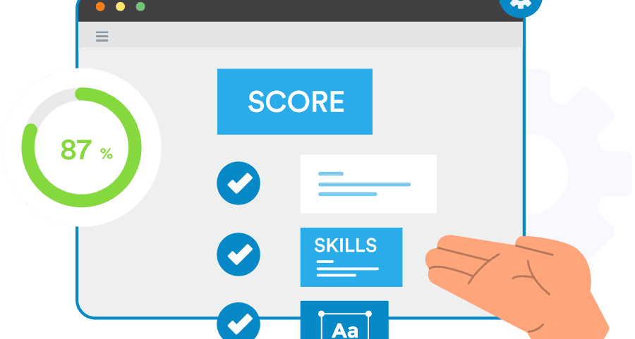
Feasibility
The development of CareerCrafter is possible due to the advancements in natural language processing and data analytics.
The project utilizes existing technologies and libraries, which makes it a practical solution for job seekers and career professionals.
Given the current market trend towards digital solutions, CareerCrafter is a timely intervention.
It uses the power of Python and machine learning to provide a service that is not only feasible but also essential for contemporary job seekers.

Slide 6

Scope
CareerCrafter aims to provide comprehensive services including:
Thorough analysis of resumes to determine experience and skill levels.
Job role matching based on current skills.
Customized skill-enhancement recommendations based on individual profiles.
Recommendations for relevant courses and certifications to fill any skill gaps.
Tips for improving resumes to create a better impression.
Access to informative videos to improve CVs and prepare for interviews.

Slide 7

Methodology & Approach
The project follows an iterative development process, incorporating user feedback to refine the analyzer's accuracy and effectiveness.
Adopting an agile methodology, CareerCrafter has been iteratively refined through market research, ensuring its alignment with the latest industry demands.
CareerCrafter takes a user-centric approach, focusing on delivering personalized recommendations that are both relevant and beneficial to the job seeker's career progression.
CareerCrafter takes a holistic approach, considering not just the resume but the entire career trajectory of the user. It’s a tool that grows with you, adapting its recommendations as you evolve professionally.

Slide 8

Hardware & Software Requirements
Devices : Cell Phones, Laptops & Desktops.
Processor : Minimum Dual Core
Memory : At least 2 GB RAM
Storage : 1 GB ROM
Operating System : Android, IOS, Windows, & MAC OS.
Web Browser : Google Chrome, Safari, Brave, Microsoft Edge

Slide 9
Tools & Technologies Used
CareerCrafter is a powerful tool that uses advanced technology to help job seekers build their resumes and achieve professional growth.
30%
25%
20%
Python
Streamlit
MySQL
10%
10%
5%
HTML
CSS
JavaScript

Slide 10
Conclusion
CareerCrafter, is a tool that aims to assist job seekers in their pursuit of professional growth by providing customized guidance.
In today's competitive job market, crafting a perfect resume is crucial. However, many job seekers find it challenging to understand how their resumes align with industry standards and expectations. CareerCrafter solves this problem by analyzing resumes and providing actionable feedback and guidance.
The development of CareerCrafter is possible due to the advancements in natural language processing and data analytics.
CareerCrafter is a powerful tool that uses advanced technology to help job seekers build their resumes and achieve professional growth.

Slide 11
THANK YOU!
Devyansh Rajput
Reg No:
devyanshrajput2022@vitbhopal.ac.in
Email:
22MCA10061

